Slide 1
Contents
Docker Storage
Docker Networks

Slide 2
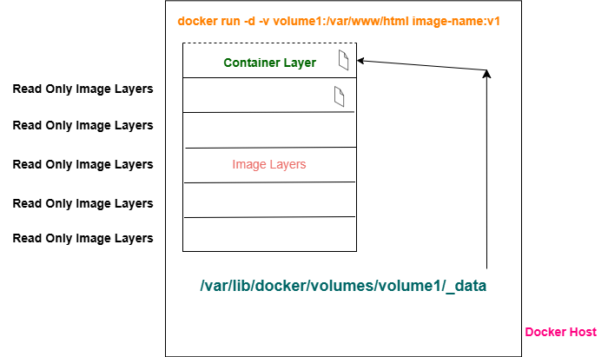
Docker Storage Basics

Slide 3
Docker Storage Theory
By default all files created inside a container are stored on a writable container layer that sits on top of the read-only, immutable image layers.
Data written to the container layer doesn't persist when the container is destroyed. This means that it can be difficult to get the data out of the container if another process needs it.
The writable layer is unique per container.
Docker supports the following types of storage mounts for storing data outside of the writable layer of the container:
Commands:
docker volume ls
docker volume create volume1
docker inspect volume1
https://docs.docker.com/engine/storage/
Volume mounts
Bind mounts
tmpfs mounts
Named pipes

Slide 4
4 Types of Storage Mounts (Please allow all mentioned ports on your AWS EC2/Azure VM/GCP Compute Engine from your laptop/vm) or Allow: 0.0.0.0/0 on the Inbound Interface)
Volume Mounts: Docker creates the directory with volume name under /var/lib/docker/volumes on the host
docker run --volume <host-path>:<container-path>
Example: docker run -d --name volcontainer –p 8082:80 -v myvolume1:/var/www/html apache2tech
Bind Mounts: Directory should be present on the host already. Only data within the mounted directory on the host will be available for the container within it.
docker run --mount type=bind,src=<host-path>,dst=<container-path>
Example: docker run -d --name bindcontainer -p 8081:80 -v --mount type=bind,src=/root/vol,dst=/var/www/html apache2tech
tmpfs: A tmpfs mount is temporary, and only persisted in the host memory. When the container stops, the tmpfs mount is removed, and files written there won't be persisted.
docker run --mount type=tmpfs,dst=<mount-path>
docker run --tmpfs <mount-path>
Named pipes: Can be used for communication between the Docker host and a container. Common use case is to run a third-party tool inside of a container and connect to the Docker Engine API using a named pipe.

Slide 5
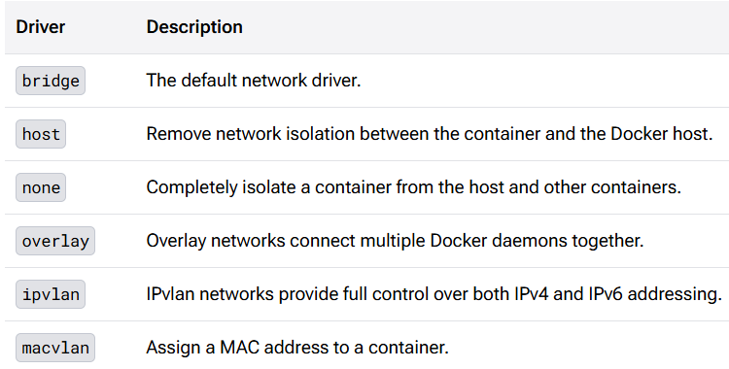
Docker Networking
Ability of containers to communicate with each other and to non-Docker workloads.
https://docs.docker.com/engine/network/

Slide 6
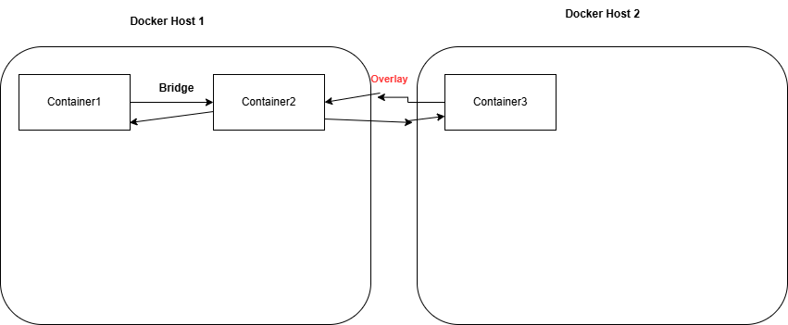
Docker Networking Diagram

Slide 7
Docker Networking Commands (Please allow all mentioned ports on your AWS EC2/Azure VM/GCP Compute Engine from your laptop/vm) or Allow: 0.0.0.0/0 on the Inbound Interface)
ip a
docker inspect docker0
docker network ls
docker inspect <container-id> | grep NetworkMode
docker inspect bridge
docker run -d --name bridgecon -p 8091:80 apache2tech
docker run -d --name bridgecon2 -p 8086:80 apache2tech
docker exec –it bridgecon2 sh
apt install inetutils-ping
ping <ip-of-bridgecon> #ping should work
docker network create mynet
docker run -d --name mynet --network mynet -p 8087:80 apache2tech
docker run -d --name mynet2 –network mynet -p 8089:80 apache2tech
docker exec -it mynet2 sh
apt install inetutils-ping
ping <ip-of-mynet> #ping should work
ping <ip-of-bridgecon> #ping should not work
docker run -d --name hostcon --network host -p 8090:80 apache2tech
docker run -d --name nonecon --network none apache2tech

